Slide 1
ITS 4.1 Finance System Enhancements Multiple your investment !!!
Session 30
Presenter : Brilliant Tleane

Slide 2
Finance Team
Product Optimization
Builds and Release Notes
Student Finance Enhancements
Core Finance Enhancements

Slide 3
Finance Team

Slide 4
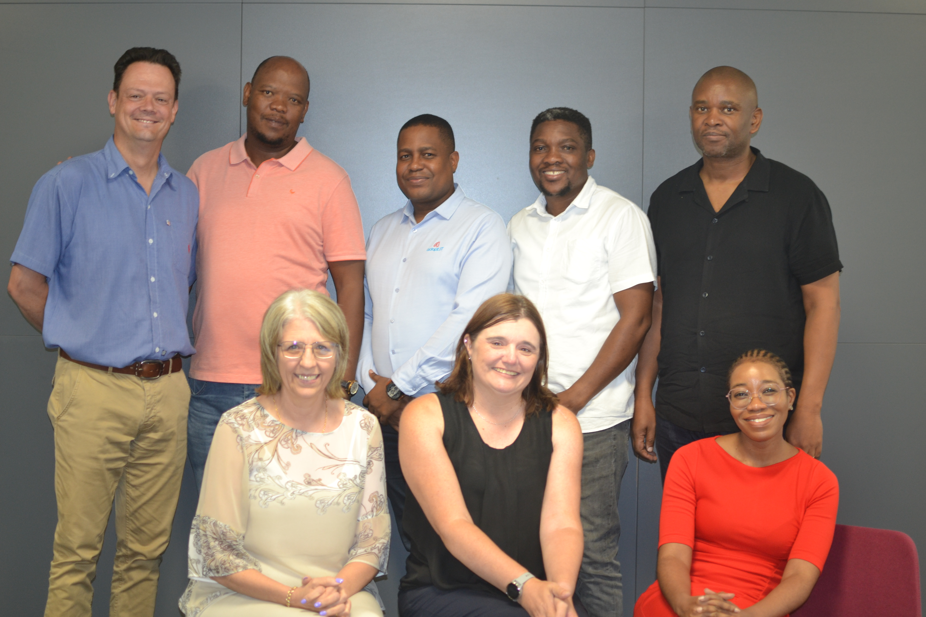
Finance Team
Back Row:
Bernard Mostert, Danny Phalane, Brilliant Tleane, Patson Marandela, Sipho Lupuwana
Front Row:
Linda Burgess, Anelia Terblanche, Sharon Mlangeni
Absent:
Zamamvula Mkhize

Slide 5
Product Optimization

Slide 6
Product Optimization
REQUIREMENTS
These would come from our external and internal stakeholders
The team would sit down and discuss the requirements and assess them.
DISCOVERY &ASSESSMENT
We would do an impact analysis and check if it is not breaking the system.
FEASIBILITY STUDY
The business development team will evaluate potential interest from other clients.
MARKET ANALYSIS
It will go into the product backlog, sprint planning, sprint
DEVELOP
PRODUCTS
The product will be available for the market

Slide 7
Build and Release Notes

Slide 8
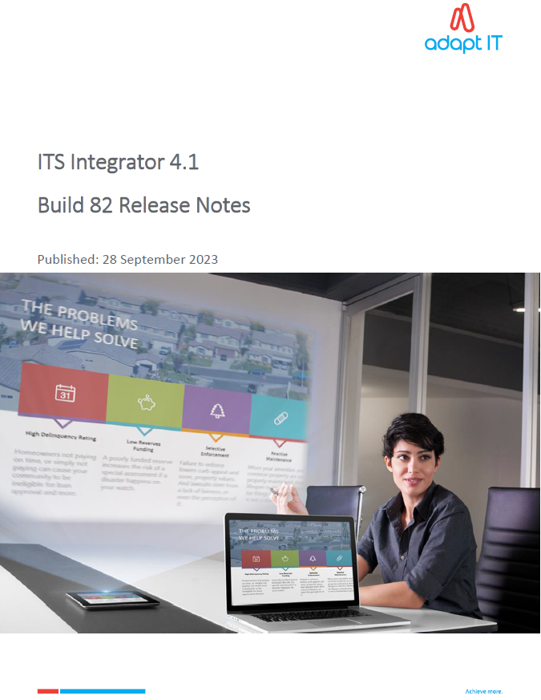
Build and Release Notes

Slide 9
Student Finance Enhancements

Slide 10
Student Finance Enhancements
Added the watermark/e-stamp to the statement to {FSAOR2-10}
Enhance Statement {FSAOR2-10} to use own logo
Stop Eduloan/Fundi if Enrolment Canceled {FBLE-16}
Realpay report for the missing dates {FSAORP-2}
Report to print Funder Information {FBLOR1-33}
Forms converted to ADF

Slide 11
Watermark/e-Stamp on Statement

Slide 12
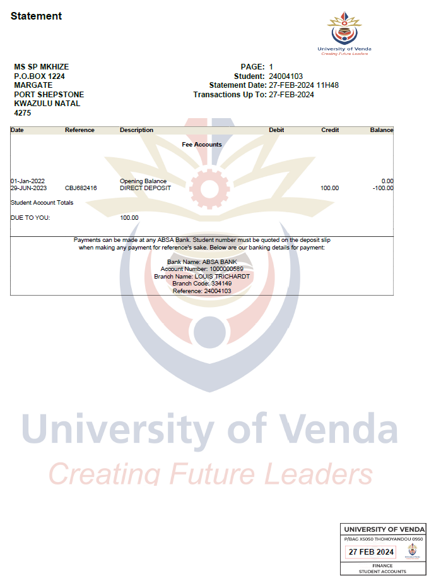
Watermark/e-Stamp on Statement

Slide 13
Enhance Statement to use own logo

Slide 14
Stop Eduloan/Fundi if Enrolment Canceled

Slide 15
Stop Eduloan/Fundi if Enrolment Canceled {FBLE-16}

Slide 16
Realpay report for the missing dates {FSAORP-2}

Slide 17
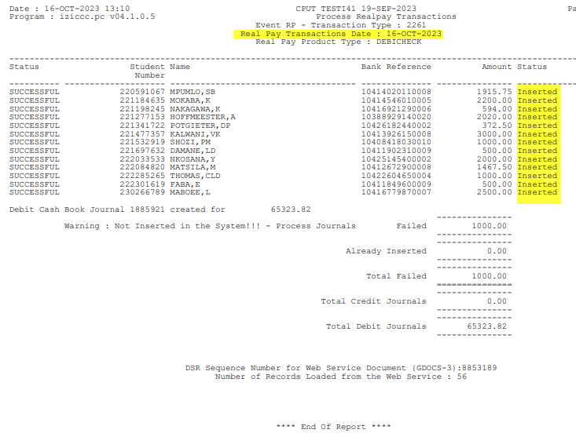
Realpay report for the missing dates {FSAORP-2}

Slide 18
Report to Print Funder Information {FBLOR1-33}

Slide 19
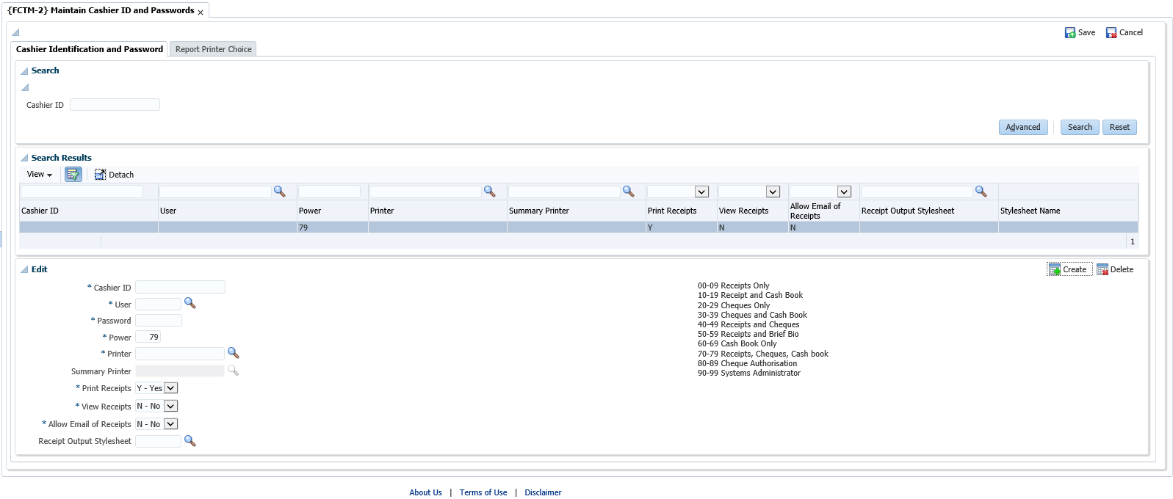
Forms converted to ADF {FCTM-2}

Slide 20
Core Finance Enhancements

Slide 21
Core Finance Enhancements
Extend AR Ageing Analysis to 365 days {FAROR1-4}
Extend PM Ageing Analysis to 120 days {FPMOR3-10}
Repeating invoice for AR {FARO-30}
Forms Converted to ADF
Reports converted to jasper and C

Slide 22
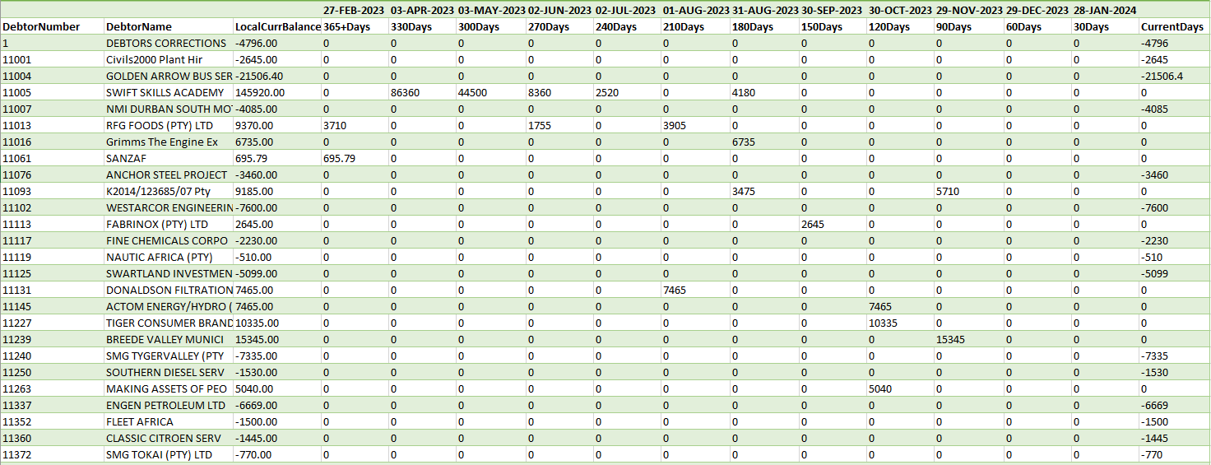
Extend AR Ageing Analysis to 365 days {FAROR1-4}

Slide 23
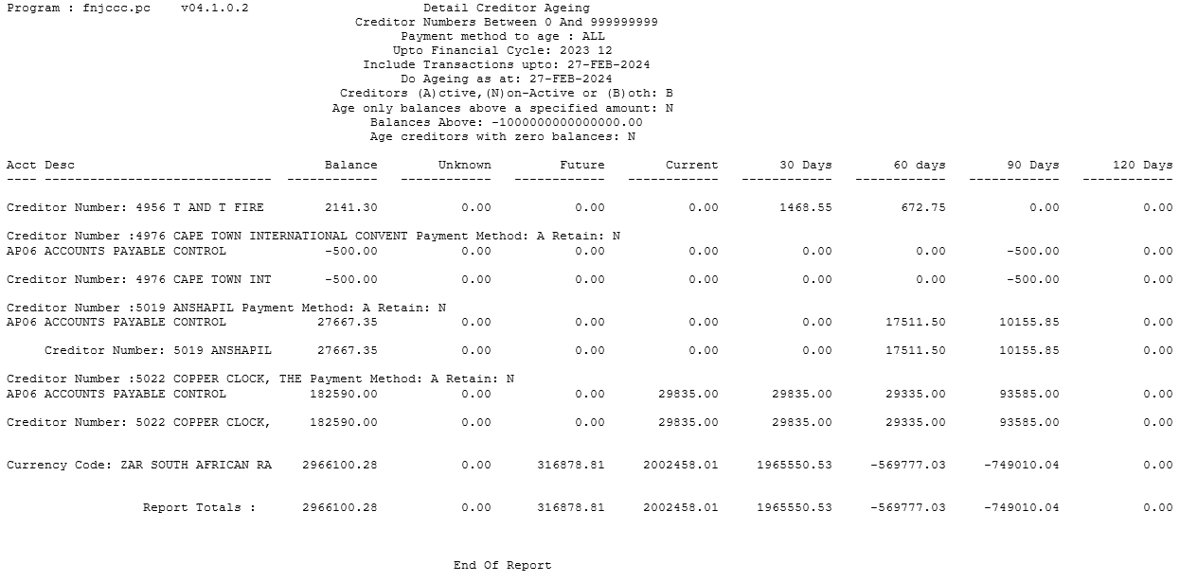
Extend PM Ageing to 120 days {FPMOR3-10}

Slide 24
Repeating Invoice for AR {FARO-30}

Slide 25
Repeating Invoice for AR {FARO-30}

Slide 26
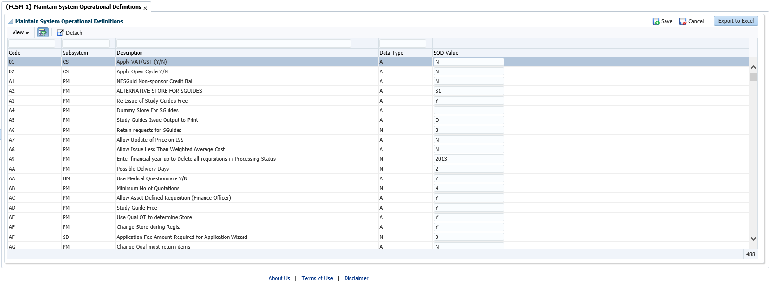
Forms converted to ADF {FCSM-1}

Slide 27
Forms converted to ADF {FCSM-8}

Slide 28
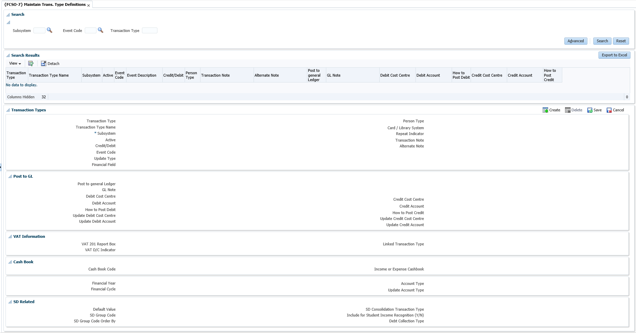
Forms converted to ADF {FCSO-7}

Slide 29
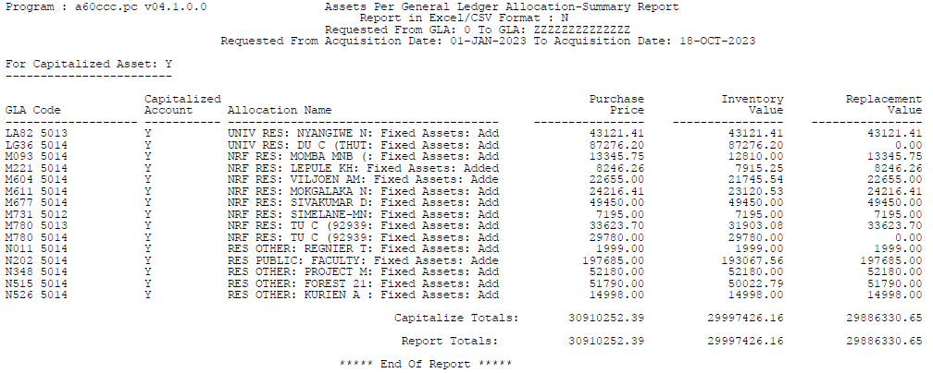
{AOPSR1-15} Converted to C

Slide 30
Questions?

